Slide 1
Digital Design Lab
Logic Gates, SOP-POS

Slide 2
Basic Gates
The AND Gate
The OR Gate
The Inverter
The NAND Gate
The NOR Gate
The XOR Gate
The XNOR Gate
NAND as Universal Gate
Gates with More Than Two Inputs
Using Inverters to Convert Gates
TTL & CMOS Logic Gates
Troubleshooting Gate Circuits
IEEE Logic Symbols

Slide 3
AND Gate (IC 7408)
OR Gate (IC 7432)
NOT Gate (IC 7404)
EX-OR Gate (IC 7486)
NAND Gate (IC 7400)
NOR Gate (IC 7402)
EX-NOR Gate (EX-OR + NOT Gate)

Slide 4
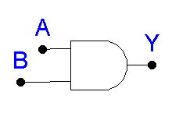
“All or Nothing Gate”
Boolean Expression: A · B = Y
Truth Table
The AND Gate

Slide 5
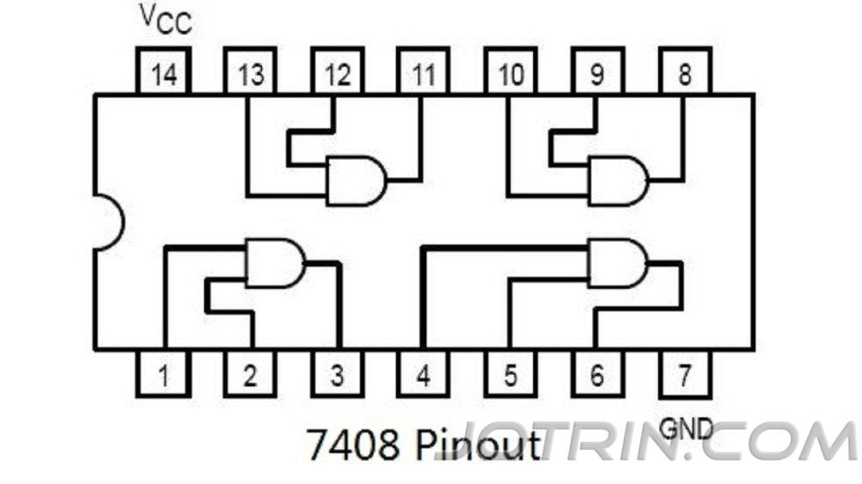

Slide 6

What is the output of the AND gate?
TEST
L
L
H
H
Low
High
?
?
L
H
H
L
Low
Low
?
?
Unique Output: Output HIGH only when all inputs are HIGH.

Slide 7
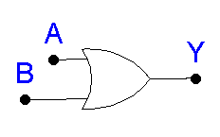
“Any or All Gate”
Boolean Expression: A + B = Y
Truth Table
The OR Gate

Slide 8
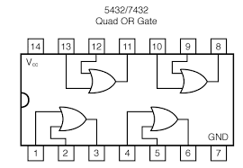

Slide 9

What is the output of the OR gate?
TEST
H
H
H
L
High
High
?
?
L
L
Low
L
H
?
High
?
Unique Output: Output LOW only when all inputs are LOW.

Slide 10
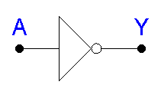
NOT Circuit
Gives output that is not the same as the input.
Boolean Expression: Y = A or Y = A'
Double inverting: A = A
The Inverter

Slide 11
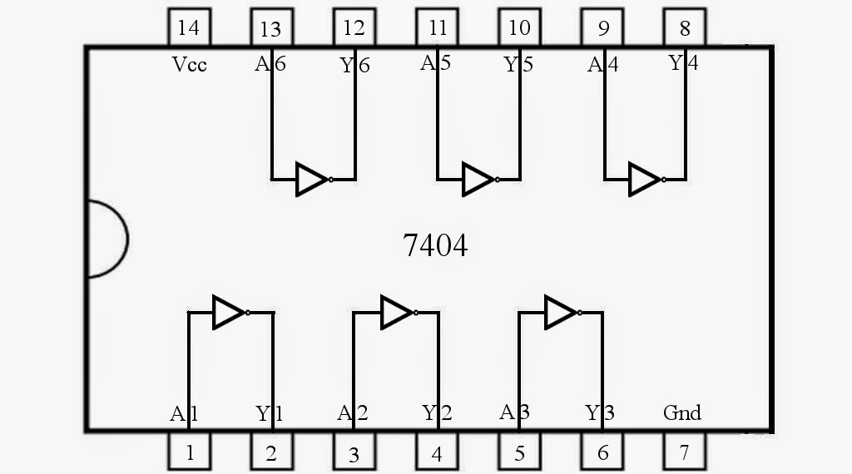

Slide 12
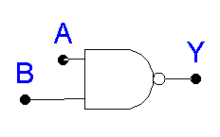
NOT AND or inverted AND function.
Boolean Expression: A · B = Y
or (A · B)' = Y
Truth Table
The NAND Gate

Slide 13
TRUTH TABLE - NAND GATE

Slide 14
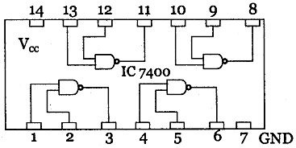

Slide 15

What is the output of the NAND gate?
TEST
L
L
L
H
High
High
?
?
H
H
H
L
Low
High
?
?
Unique Output: Output LOW only when all inputs are HIGH.

Slide 16
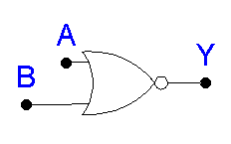
NOT OR or Inverted OR
Boolean Expression: A + B = Y
or (A + B)' = Y
Truth Table
The NOR Gate

Slide 17
TRUTH TABLE - NOR GATE

Slide 18
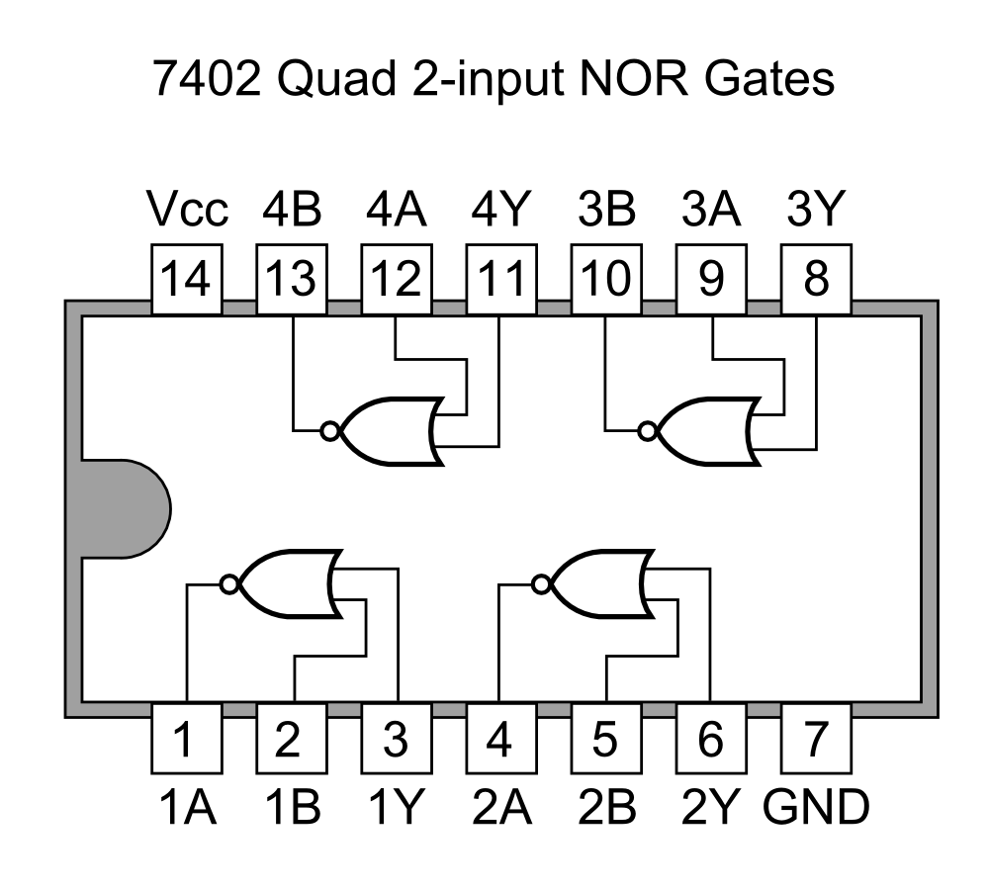

Slide 19
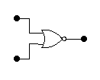
TEST
What is the output of the NOR gate?
L
L
L
H
High
Low
?
?
H
L
Low
H
H
?
Low
?
Unique Output: Output HIGH when all inputs are LOW.

Slide 20
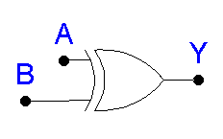
Known as “Exclusive OR” Gate
“Anything but not all” Gate
Boolean Expression: A ⊕ B = Y
Truth Table
The XOR Gate

Slide 21
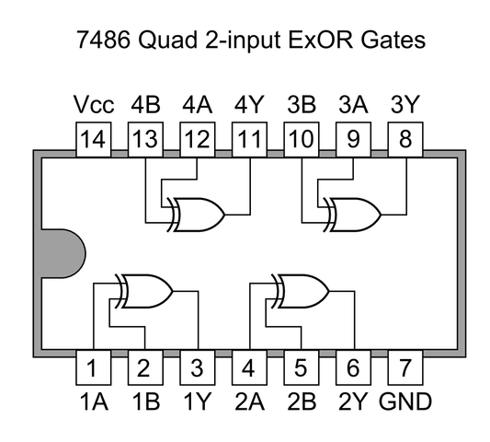

Slide 22

What is the output from the XOR gate?
TEST
L
L
L
L
L
H
High
?
?
?
Low
H
H
H
H
H
L
High
?
?
?
Low
XOR output is HIGH only when odd number of inputs are HIGH

Slide 23
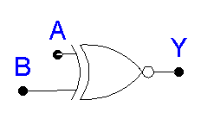
Known as the Exclusive NOR Gate
The Inverted XOR
Boolean Expression: A ⊕ B = Y
or (A ⊕ B)' = Y
Truth Table
The XNOR Gate

Slide 24
TRUTH TABLE - XNOR GATE

Slide 25

TEST
What is the output from this XNOR gate?
L
L
L
High
L
H
L
?
Low
?
H
H
L
H
H
H
Low
High
?
?
XNOR output is HIGH only when odd number of inputs are LOW

Slide 26
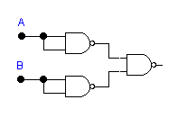

THE NAND AS A UNIVERSAL GATE
“Universal gate” can be used in combination to create any other logic function.
Example:
A + B
A + B

Slide 27
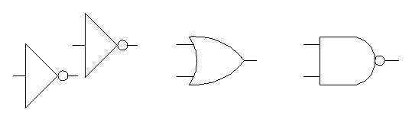
USING INVERTERS TO CONVERT GATES
For example:

Slide 28
PRACTICAL LOGIC GATES
ICs - Integrated circuits
TTL Family of ICs
CMOS (MOS - Metal oxide semiconductor) Family of ICs

Slide 29
TROUBLESHOOTING SIMPLE GATE CIRCUITS
Logic probe - equipment used to test circuits
Feel top of IC to determine if it is hot
Look for broken connections, signs of excessive heat
Smell for overheating
Check power source
Trace path of logic through circuit

Slide 30
IEEE LOGIC SYMBOLS
A different set of symbols without unique shapes.
Not very popular at this time.
Examples:
A
B
&
Y
AND gate
A
B
1
Y
OR gate

Slide 31
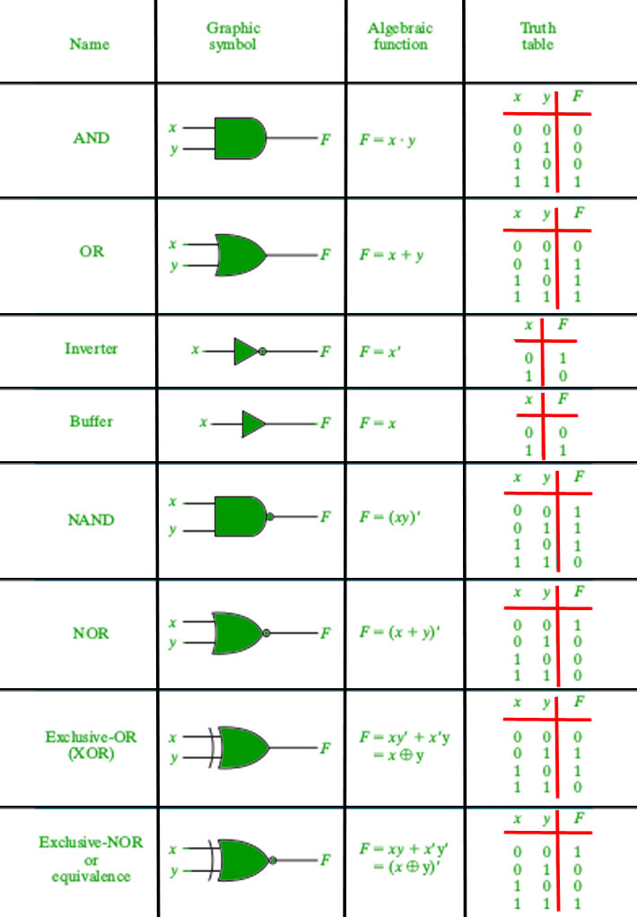

Slide 32
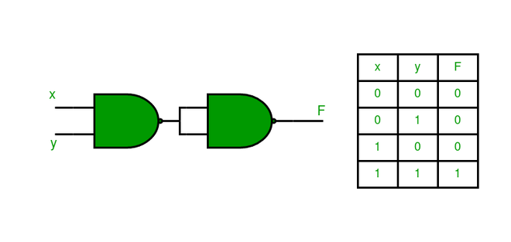
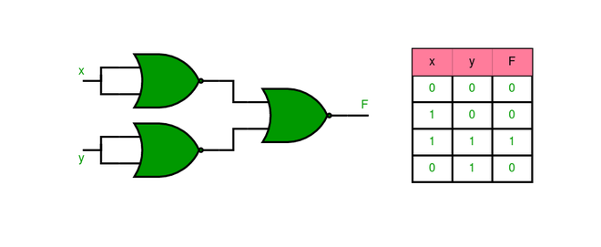
NAND as AND
NOR as AND

Slide 33
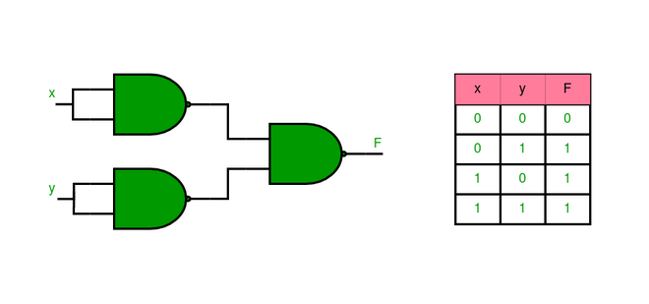
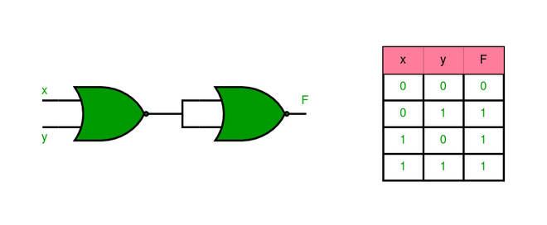
NAND as OR
NOR as OR

Slide 34
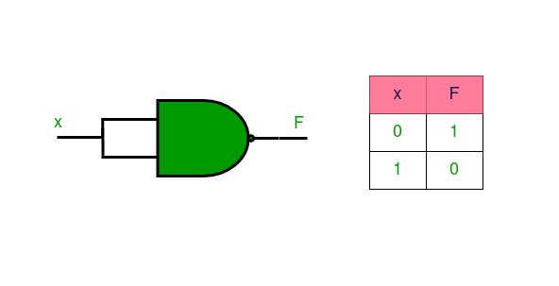
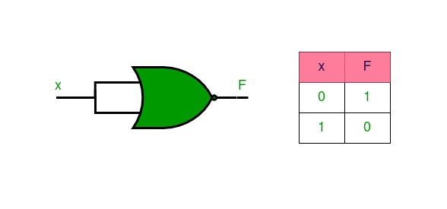
NAND as NOT
NOR as NOT

Slide 35
Properties of Boolean Algebra
A.0 = 0 A +1 = 1 | Annulment law
A + 0 = 1 A.1 = A | Identity
A + A = A A.A = A | Idempotent
A + A’ = 1 A.A’ = 0 | Complement Law
((A)’)’=A | Double Negation Law
A + B = B + A A.B = B.A | Commutative Law
A+(B+C) = (A+B)+C A.(B.C) = (A.B).C | Associative Law
A.(B+C) = (A.B)+(A.C) (A+B)(A+C) = A + BC | Distributive Law

Slide 36
Canonical and Standard Form
Boolean Function is represented by:
Canonical Disjunctive Normal Form known as minterm
Canonical Conjunctive Normal Form known as maxterm.
Minterm -> functions where the output results in “1”
Maxterm -> functions where the output results in “0”
Sum of minterm - > SOP
Sum of maxterms - > POS
Standard Form – A Boolean variable can be expressed in either true or complementary forms.

Slide 37
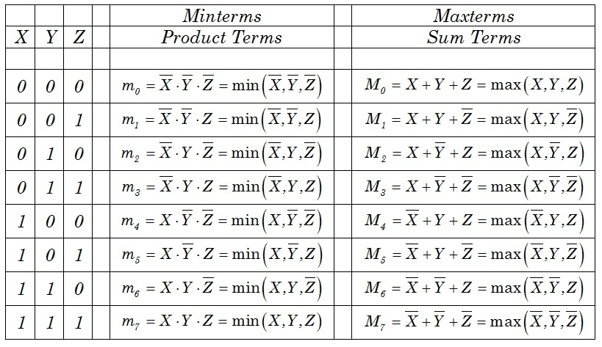
Minterm is expressed in product format and Maxterm is expressed in sum format.

Slide 38
1. Express the Boolean function F = A + B’C as standard sum of minterms. (canonical SOP form)
Solution –
A = A(B + B’) = AB + AB’
This function is still missing one variable, so
A = AB(C + C’) + AB'(C + C’) = ABC + ABC’+ AB’C + AB’C’
The second term B’C is missing one variable; hence,
B’C = B’C(A + A’) = AB’C + A’B’C
Combining all terms, we have
F = A + B’C = ABC + ABC’ + AB’C + AB’C’ + AB’C + A’B’C
But AB’C appears twice, and according to theorem 1 (x + x = x), it is possible to remove one of those occurrences. Rearranging the minterms in ascending order, we finally obtain
F = A’B’C + AB’C’ + AB’C + ABC’ + ABC
= m1 + m4 + m5 + m6 + m7
SOP is represented as Σ (1, 4, 5, 6, 7)

Slide 39
2. Express the Boolean function F = xy + x’z as a product of maxterms (canonical POS form)
Solution –
F = xy + x’z = (xy + x’)(xy + z) = (x + x’)(y + x’)(x + z)(y + z) = (x’ + y)(x + z)(y + z)
x’ + y = x’ + y + zz’ = (x’+ y + z)(x’ + y + z’)
x + z = x + z + yy’ = (x + y + z)(x + y’ + z)
y + z = y + z + xx’ = (x + y + z)(x’ + y + z)
F = (x + y + z)(x + y’ + z)(x’ + y + z)(x’ + y + z’)
= M0*M2*M4*M5 ,
POS is represented as π(0, 2, 4, 5)

Slide 40
3. Convert Boolean expression in standard form SOP F=y’+xz’+xyz
Solution :
F = (x+x’)y'(z+z’)+x(y+y’)z’ +xyz
F = xy’z+ xy’z’+x’y’z+x’y’z’+ xyz’+xy’z’+xyz
4. F(A, B, C) = ∑(1, 4, 5, 6, 7) Find the boolean equation.

Slide 41
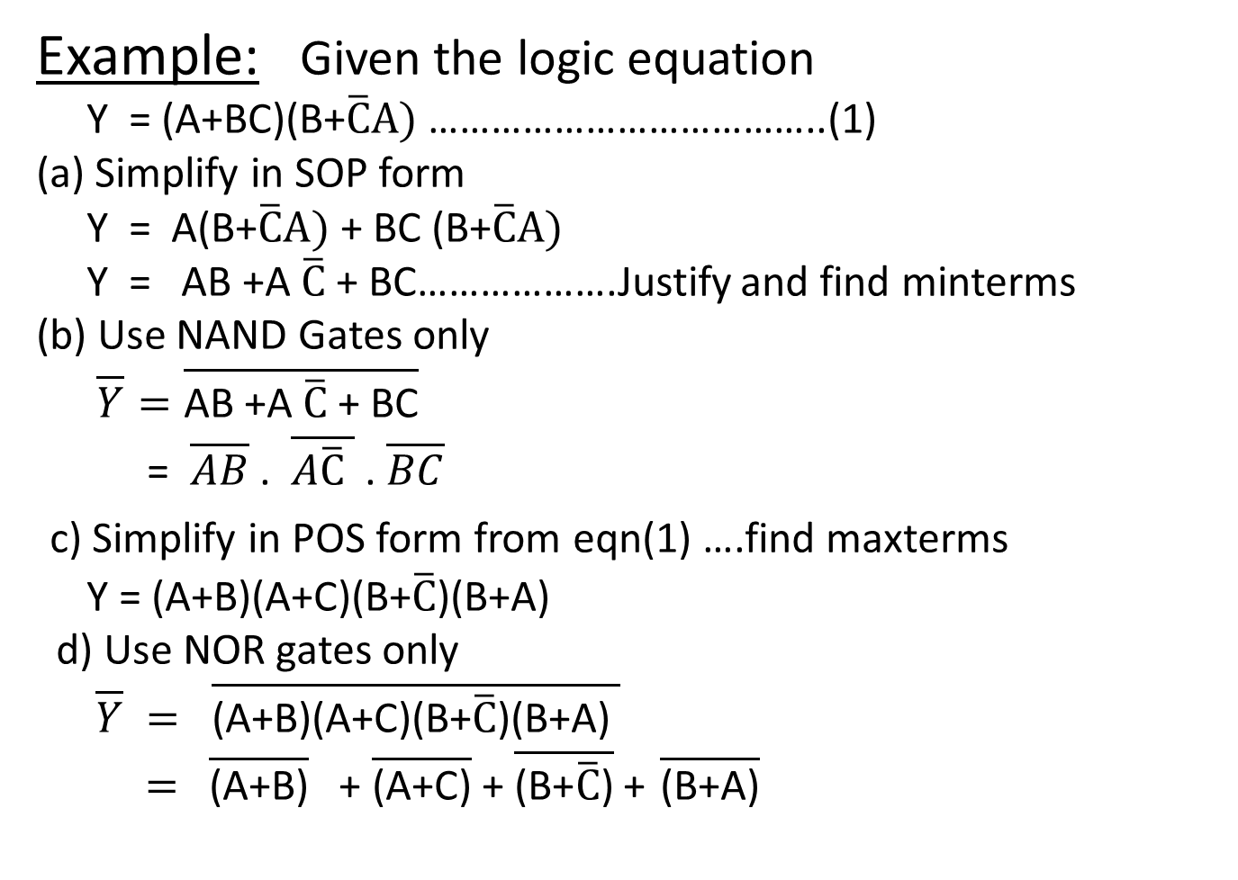
Example: Given the logic equation
Y = (A+BC)(B+$\overline{C}A)$ ………………………………..(1)
(a) Simplify in SOP form
Y = A(B+$\overline{C}A)$ + BC (B+$\overline{C}A)$
Y = AB +A $\overline{C}$ + BC……………….Justify and find minterms
(b) Use NAND Gates only
$\overline{Y}=\overline{\text{AB}\text{ +}\text{A} \overline{C}\text{ + }\text{BC}}$
= $\overline{AB}$ . $\overline{A\overline{C} }$ . $\overline{BC}$
c) Simplify in POS form from eqn(1) ….find maxterms
Y = (A+B)(A+C)(B+$\overline{C}$)(B+A)
d) Use NOR gates only
$\overline{Y} = \overline{\text{(}\text{A}\text{+}\text{B}\text{)(}\text{A}\text{+}\text{C}\text{)(}\text{B}\text{+}\overline{C}\text{)(}\text{B}\text{+}\text{A}\text{) }}$
$=$ $\overline{\text{(}\text{A}\text{+}\text{B}\text{)}}$ + $\overline{\text{(}\text{A}\text{+}\text{C}\text{)}}$ + $\overline{\text{(}\text{B}\text{+}\overline{C}\text{)}}$ + $\overline{\text{(}\text{B}\text{+}\text{A}\text{)}}$

Slide 42
Karnaugh Maps (K-Maps)
A visual way to simplify logic expressions
It gives the most simplified form of the expression

Slide 43
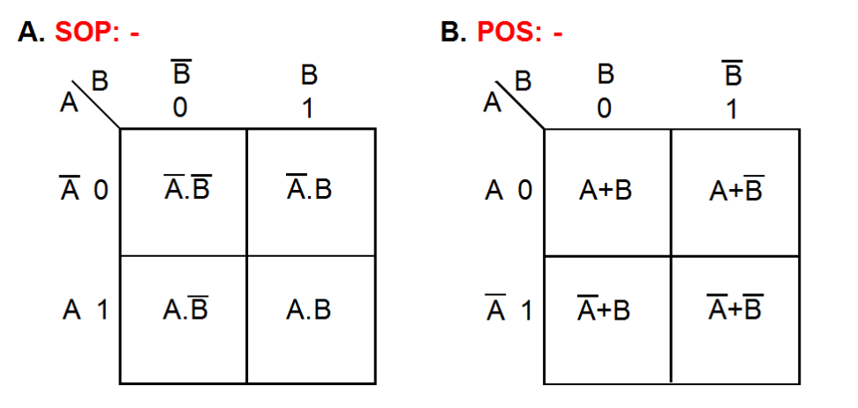
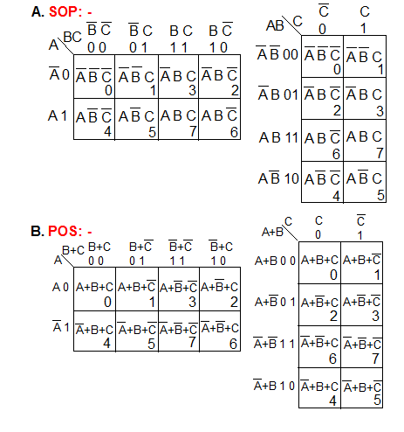
Karnaugh Map Representation of Logic Functions: 2 variables, 3 variables, 4 variables
Alternate ways to arrange variables A,B, and C in 3 variables k-map as shown below: Accordingly minterm positions will change.

Slide 44
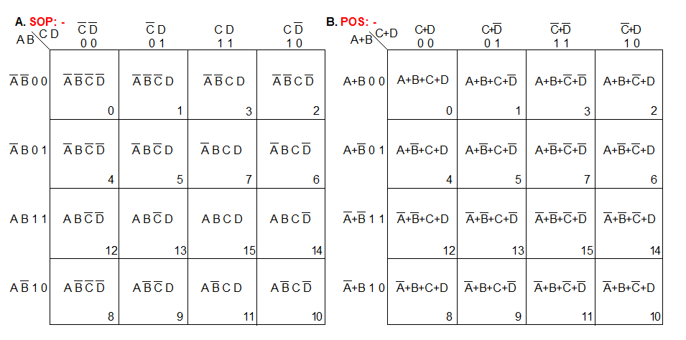

Slide 45
Rules to obtain the most simplified expression
Simplification of logic expression using Boolean algebra is awkward because:
it lacks specific rules to predict the most suitable next step in the simplification process
it is difficult to determine whether the simplest form has been achieved.
A Karnaugh map is a graphical method used to obtained the most simplified form of an expression in a standard form (Sum-of-Products or Product-of-Sums).
The simplest form of an expression is the one that has the minimum number of terms with the least number of literals (variables) in each term.
By simplifying an expression to the one that uses the minimum number of terms, we ensure that the function will be implemented with the minimum number of gates.
By simplifying an expression to the one that uses the least number of literals for each terms, we ensure that the function will be implemented with gates that have the minimum number of inputs.

Slide 46
Three-Variable K-Maps

Slide 47
Three-Variable K-Map Examples

Slide 48
Four-Variable K-Maps

Slide 49
Four-Variable K-Maps

Slide 50
Four-Variable K-Maps Examples

Slide 51
Four-Variable K-Maps Examples

Slide 52
Four-Variable K-Maps Examples

Slide 53
Design of combinational digital circuits
Steps to design a combinational digital circuit:
From the problem statement derive the truth table
From the truth table derive the unsimplified logic expression
Simplify the logic expression
From the simplified expression draw the logic circuit
Example: Design a 3-input (A,B,C) digital circuit that will give at its output (X) a logic 1 only if the binary number formed at the input has more ones than zeros.

Slide 54
Design of combinational digital circuits (Cont.)
Example: Design a 4-input (A,B,C,D) digital circuit that will give at its output (X) a logic 1 only if the binary number formed at the input is between 2 and 9 (including).

Slide 55
Design of combinational digital circuits (Example)
Example: Design a 4-input (A,B,C,D) digital circuit that will give at its output (X) a logic 1 only if there more ones than zeros in the binary number formed at the input.

